Slide 1

Learning Euler Fluid Equation Discontinuities with a Fourier Neural Operator
CS230 – Deep Learning
Taylor Brodine
Ian Hokaj

Slide 2
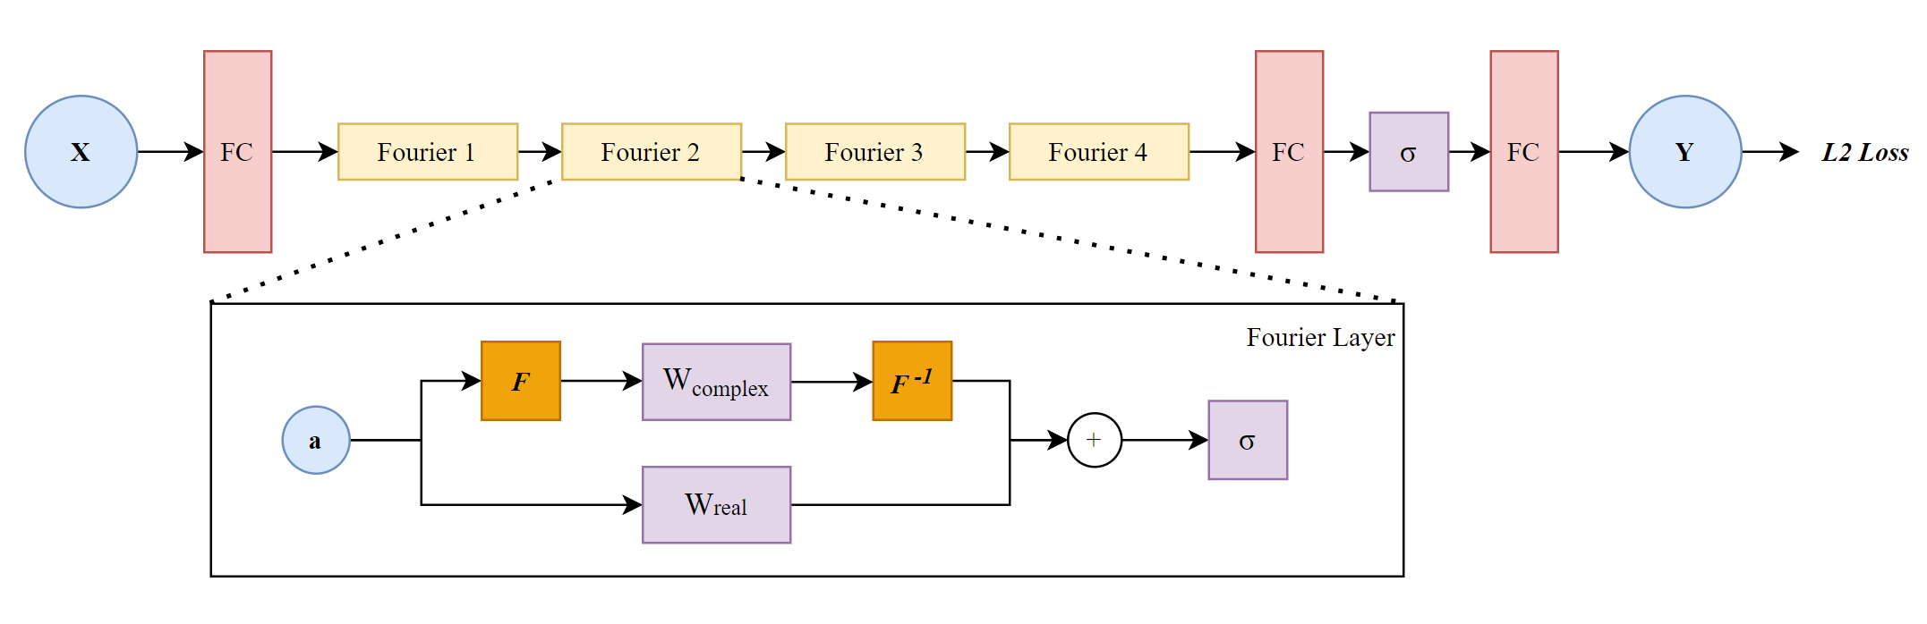

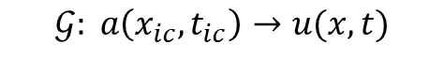
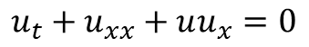
Fourier Neural Operator (FNO) Overview
Key Idea: Learn approximation of PDE solution operator
Take a standard PDE:
$$u_{t}+u_{xx}+uu_{x}=0$$
There exists an operator $𝒢$ mapping between initial/boundary conditions and solutions :
$$𝒢: a\left(x_{ic},t_{ic}\right)→u(x,t)$$
This mapping is learned by Fourier Neural Operator:
Benefits:
No prior knowledge of PDE required
Resolution-invariant
[1] Zongyi Li et al. “Fourier Neural Operator for Parametric Partial Differential Equations,” 2020.

Slide 3
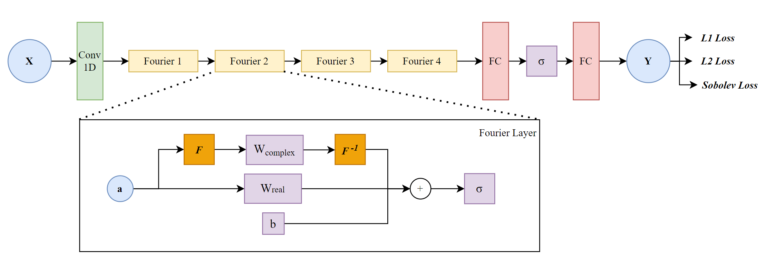
FNO Modifications
Network | Notes
Li FNO | Baseline
U-Net | Baseline
Modified FNO | 1D Conv Upscaling Layer Spatial Bias layer Range normalization Multiple loss functions

Slide 4
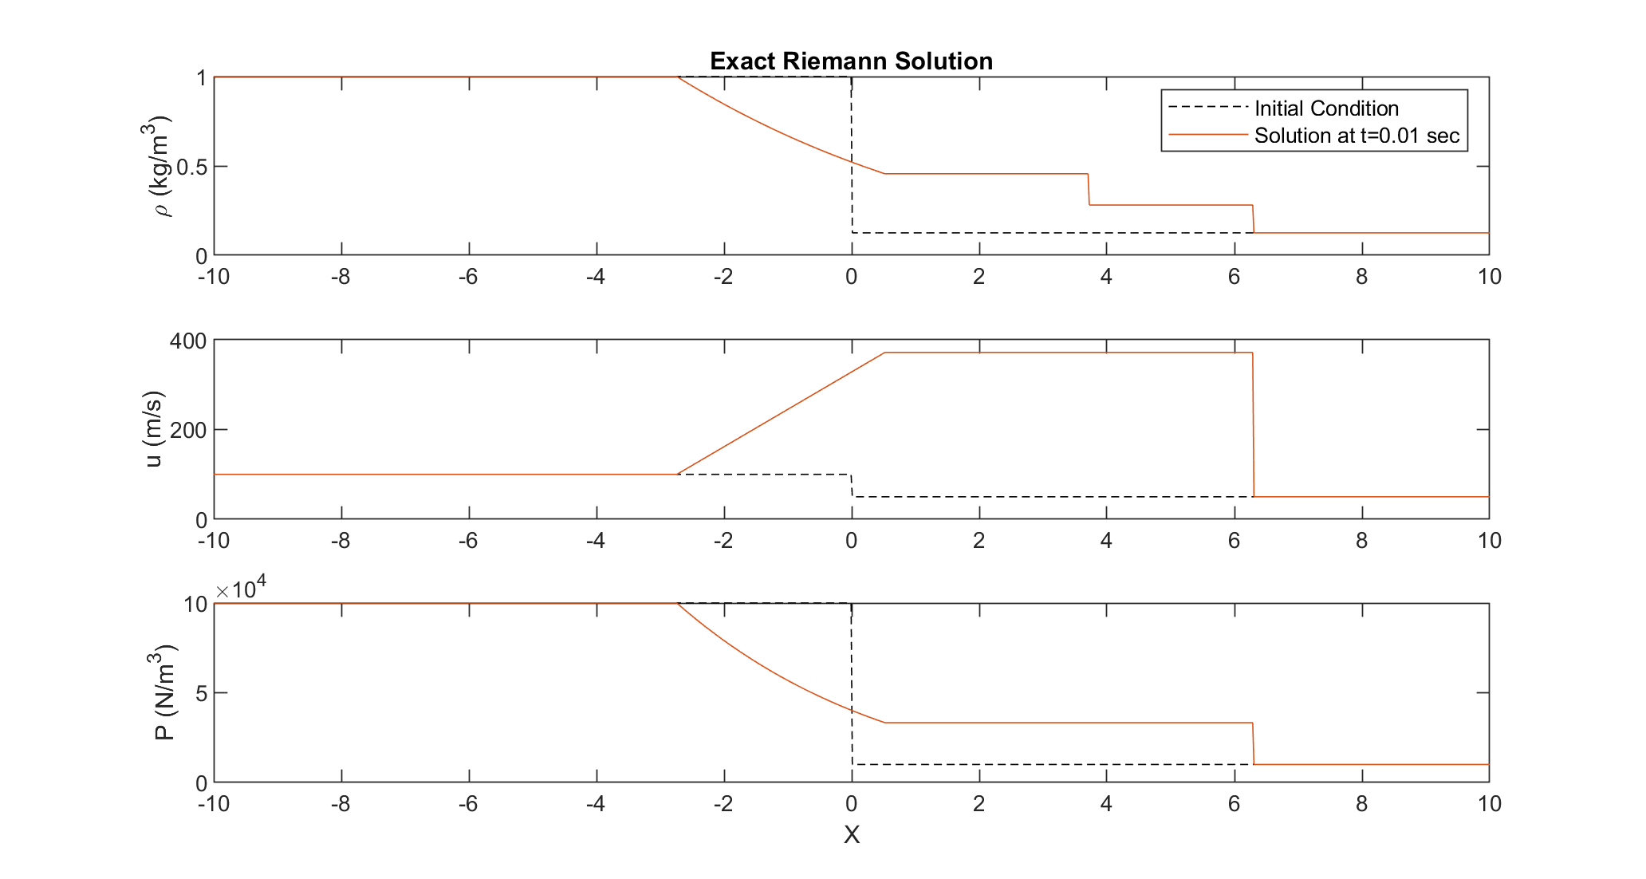
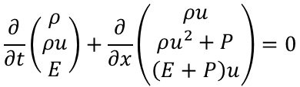
Problem Statement & Data Generation
Solving the Euler Fluid Equations (system of PDEs) for a Riemann Problem (shock tube):
$$\frac{∂}{∂t}\left(\begin{matrix}ρ \\ ρu \\ E\end{matrix}\right)+\frac{∂}{∂x}\left(\begin{matrix}ρu \\ ρu^{2}+P \\ \left(E+P\right)u\end{matrix}\right)=0$$
Solve system analytically using self-similarity from uniform random initial conditions for the left and right states
*Solution contains discontinuities (shock waves)
[2] Charbel Farhat. “Representative Model Problems”. In: AA214: Numerical Methods for Compressible Flows, Course Notes, Ch5 (2022).

Slide 5
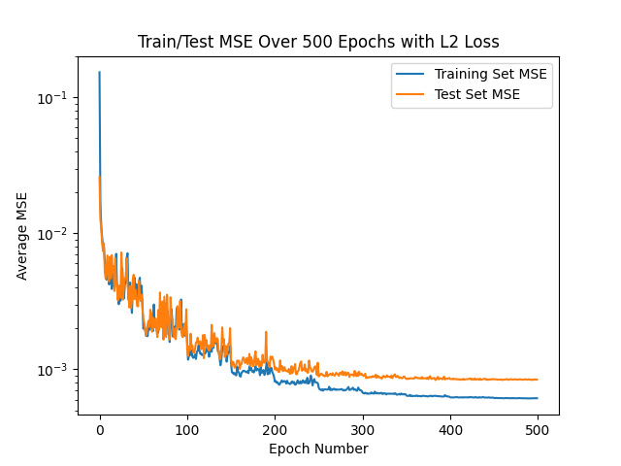
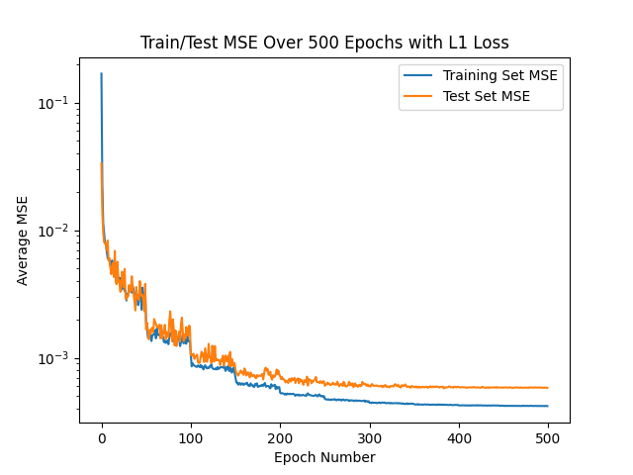
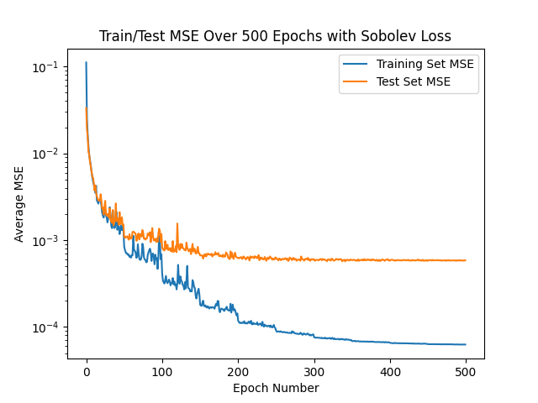
Training Results
Tuned Hyperparameter | Value
No. of Fourier modes | 16
Upscale channel width | 64
Epochs | 500
Learning rate | 0.005
Scheduling step | 100
Scheduling factor | 0.5
Normalization | Range
Train time | 389.244
Train/Test split | 1000/100
Batch size | 20

Slide 6
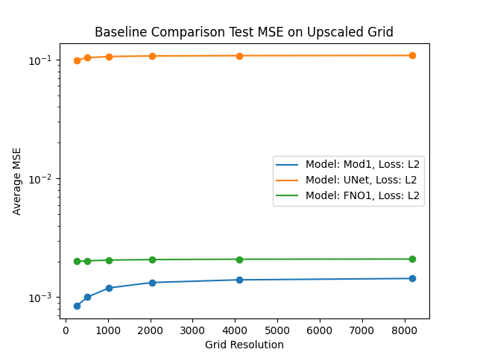
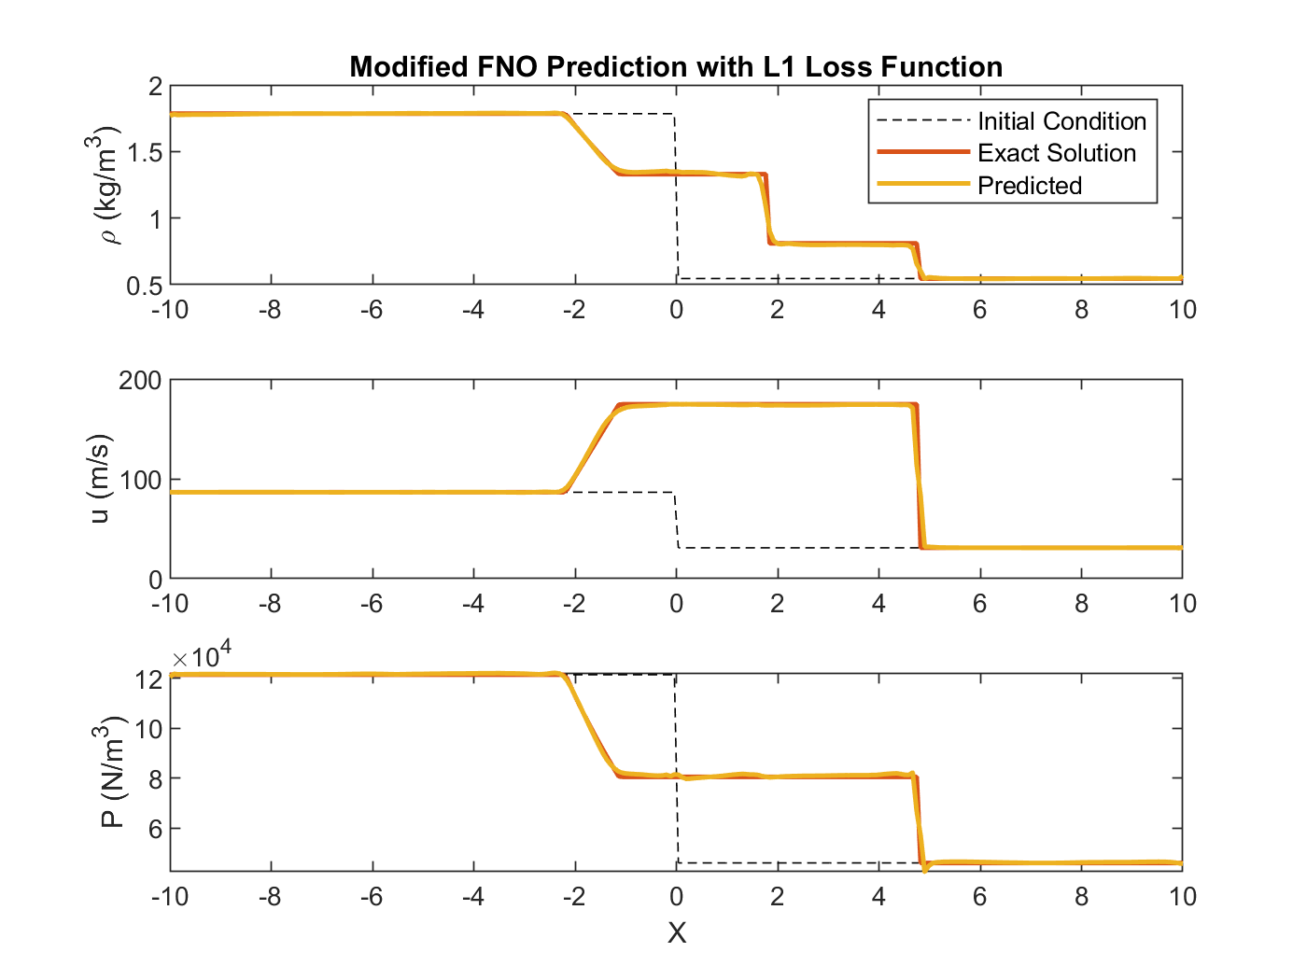
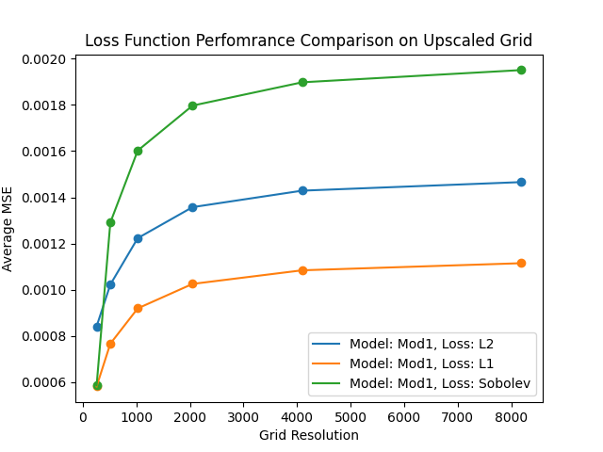
Upscaling Performance

Slide 7
THANK YOU

